Slide 1

Dnalsi
Sharon Christner, Nick Maxwell, James Willis, Logan Brosemer, Nate Roth, Ian Garcia, Ryan McMullin, Megan Allen
Island Government Constitution Project
Honors Government
Period 5

Slide 2
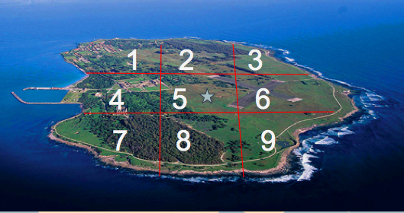
Geography
= Capital, Latipac

Slide 3

Flag

Slide 4
Structure of Power
Unitary Structure
National Government
Flow Of Power
Local Districts
Local Districts
Local Districts
Local Districts
Local Districts

Slide 5
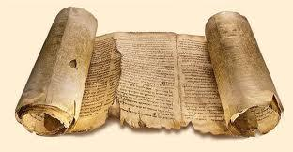
Preamble
We the people of Dnalsi, in order to form a more perfect island, pledge to establish order, justice, and equality towards the common goal of success and prosperity in the establishment of the Constitution of this nation.

Slide 6
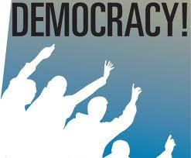
Government System
Representative Democracy
All citizens over 18 eligible for election
Checks and Balances
Religion can not be made law

Slide 7
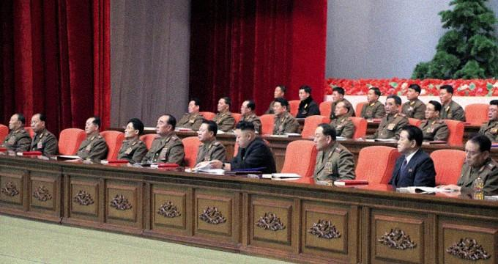
Political Representation
Officials are elected by the people
Every citizen has the right to vote
9 officials elected 10 years nationally
9 officials elected every 5 years locally
Voting age to be set at 18

Slide 8
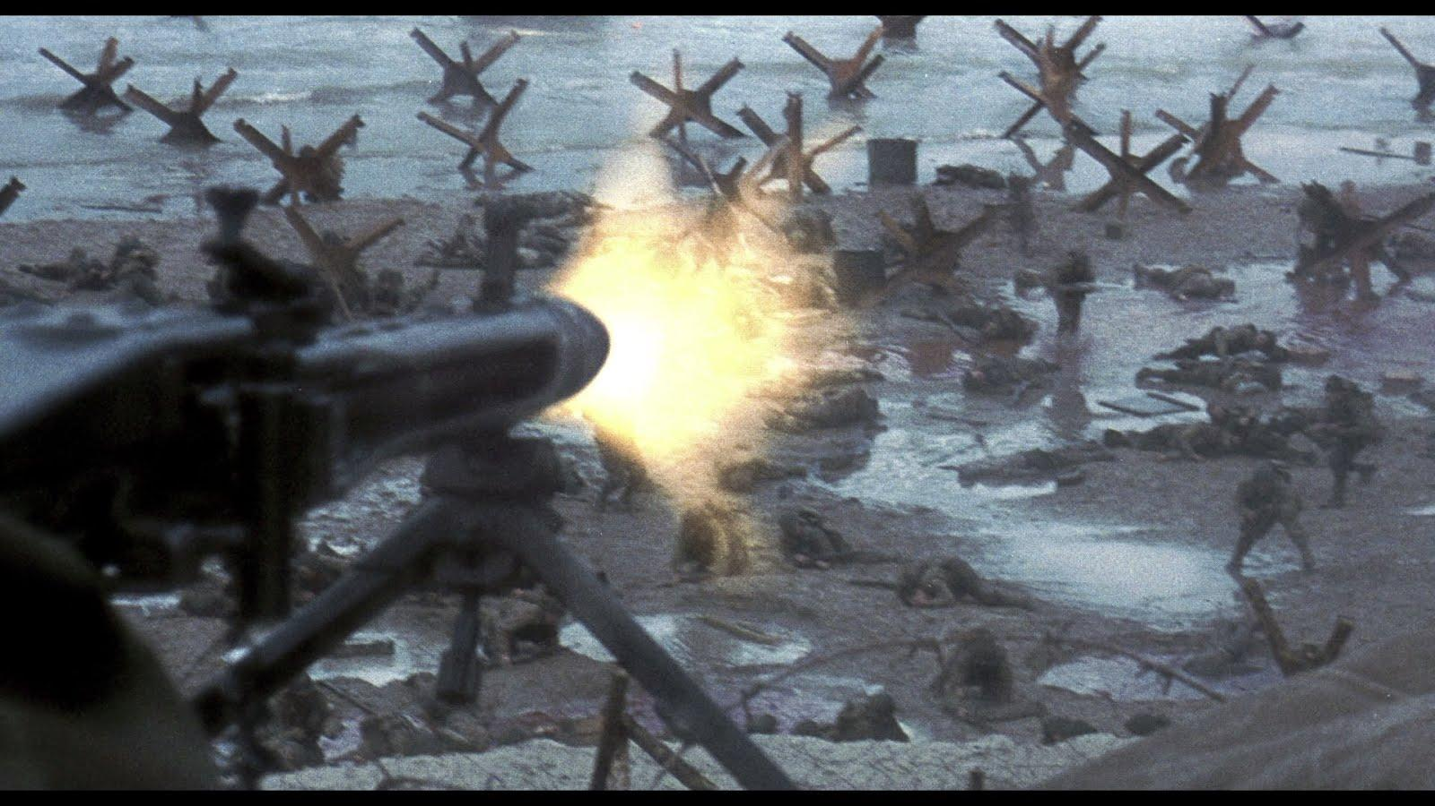
Powers of National Government
National government controls all affairs
May write, enforce, and interpret laws
May tax citizens
Controls social services and aid
May declare war

Slide 9
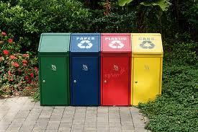
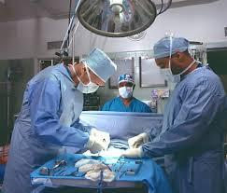
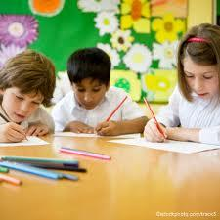
Powers of Local Government
Manages waste disposal
Provides medical care
Oversees education according to standards set by national government

Slide 10
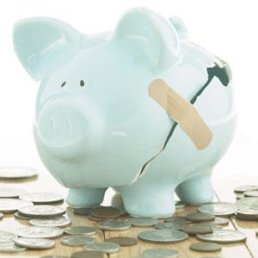
Economic Status
Fundamentally socialist
Offers a variety of social programs to citizens including healthcare and education
Government has limited involvement with economic markets, controlling only vital resources
Government retains control of major natural resources, including fishing and lumber

Slide 11
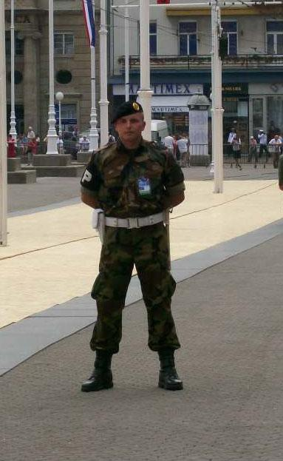
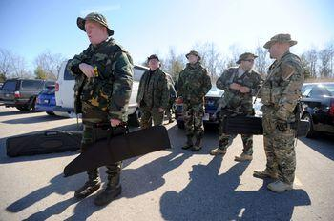
Military Control
Military comprised of small infantry units and light artillery
U.S. will be allowed to maintain a military presence and establish military bases on the island in exchange for protection and military training
Island is actively seeking peaceful relations and military partnership with U.S.

Slide 12
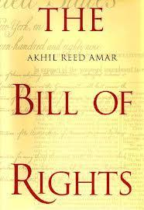
Bill o’ Rights
Our Constitution will include 4 basic rights.
Freedom of Speech
Freedom of Press
Freedom of Religion
Gender Equality Rights
These will be unalienable rights stated in our Preamble and tolerance is highly encouraged among the different groups.

Slide 13
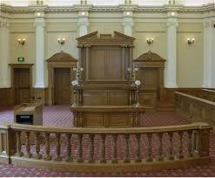
Law And Justice
Each section has a large court
Three smaller courts in that region
Smaller courts trumped by large court
The national government chooses the Judges.

Slide 14
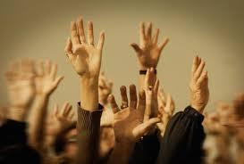
Ratification
Ratification of 6 out of 9 sections on the island.
village councils will vote on the new government.

Slide 15
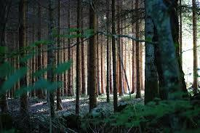
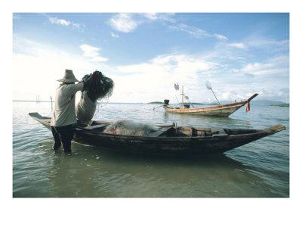
Poverty Solution
Government owns lumber and fishing industries
Gives jobs to the poor in both industries
Tax wealthy families to assuage poverty

Slide 16
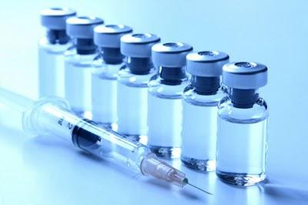
Disease Control
Dnalsi receives assistance from the UN’s fund set aside to help developing nations fight disease
Vaccines, medicine, and mosquito nets are provided to the public due to the population’s increasing amount of Malaria victims

Slide 17
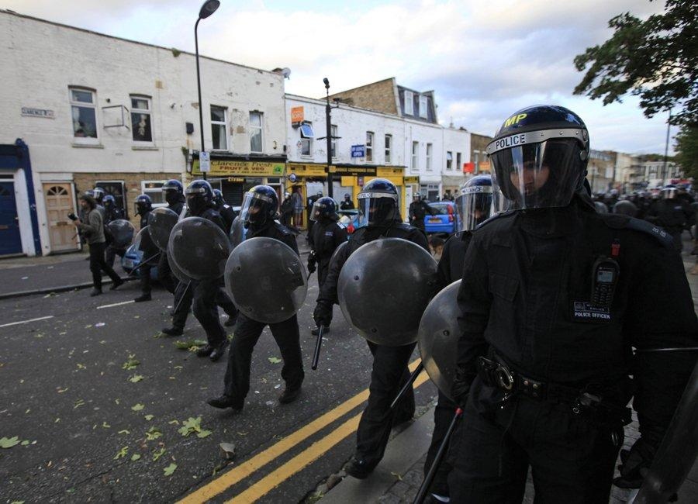
Dealing With Religious Violence
Dnalsi has a police force; It is used if violence is extreme such as riots or revolts
There is a law allowing freedom of religion, and religious tolerance is highly exercised

Slide 18
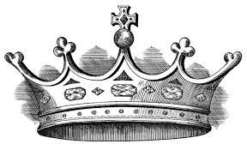
Former Monarch
King Fattah is no longer a king, but he is allowed to be elected into the government should the people elect him
If he is elected into the Dnalsi government he will not have complete control, but he will have a say in government business

Slide 19


Dutch Loyalists
Loyalists will be provided with free passage to the Netherlands or any other Dutch controlled region.
Loyalists will be awarded citizenship should they choose to remain on the island
These provisions may be retracted in the event of rebellion or uprising
The loyalists will be assured that they can vote and thus elect leaders that represent them

Slide 20

Education
Mandatory reading classes will be necessary for all residence of the island over the age of 6
If the test at the end of the course is passed the reading class is no longer mandatory.
The class will be free.
If anyone has trouble passing the course they can repeat it until passed.

